Slide 1

Readying for Change:
A Trauma-Informed Approach to Wellness
Brenda Ingram, EdD, MSW, LCSW
Clinical Assistant Professor, Psychiatry and Behavioral Sciences Department
USC Keck School of Medicine

Slide 2


Let’s Take A Moment to Breath…
And Acknowledge Our History—
This is an acknowledgement that the area, now called Los Angeles County, is on the traditional homelands of the Chumash, Tataviam and Tongva people. We recognize that the taking of these lands from the original inhabitants by colonization, enslavement, genocide, displacement, and other acts of violence created traumatic impacts on generations of Native peoples.
We further acknowledge, that Los Angeles County is currently the home of the largest population of indigenous people in the United States.
We give our respects to of all the ancestors, elders and relations, past, present and future;
And we support reparations and healing to right these past traumas.

Slide 3

Trauma Informed DEI
“Trauma is at the heart of diversity, equity, and inclusion work because repeated acts of marginalization, oppression and racism are wounds that overwhelms one's ability to cope”– Dr. Laura Quiros, PhD, LMSW, 2022
Notes:
The practices of diversity, equity, and inclusion are practices in creating organizational cultures where there is a shared feeling of Belonging in the face of our complexity as a people. How do we, as leaders and members of our organizations, create the opportunities to open up mindsets and build dialogue spaces to foster growth and belonging?

Slide 4

TRAUMA
Understanding trauma is not just about acquiring knowledge.
It’s about changing the way you view the world.
It’s about changing the helping paradigm from “What is wrong with you?” to “What happened to you?”
                Sandra Bloom, MD, 2007

Slide 5

What is Trauma?
An event or series of events that overwhelm the mind, body and spirit to be in balance.
Trauma is defined using eight general dimensions:
  Threat to life or limb;
  Severe physical harm or injury, including sexual assault;
  Receipt of intentional harm or injury;
  Exposure to the grotesque;
  Violent, sudden loss of a loved one;
  Witnessing or learning of violence to a loved one;
  Learning of exposure to a noxious agent; and
  Causing the death or severe harm to another (Wilson & Sigman, 2000)

Slide 6
Types of Trauma
Physical
Medical
Psychological
Social or Collective
Historical or Intergenerational
Immigration
Developmental
Racial
Environmental
Chronic, Ongoing, and Enduring
Vicarious, Secondary or Compassion Fatigue

Slide 7
Adverse Childhood Experiences = Developmental/Childhood Trauma
Adverse Childhood Experiences (ACE) Study (1998) A pivotal retrospective study that quantified the impact of traumatic experiences.
  Close to 70% of Kaiser adult patients (n=17,000) reported at least one traumatic experience before the age of 18. Almost 50% report 1-3 traumatic events.
  Philadelphia Urban ACEs included community factors, e.g., community violence, discrimination, foster care, etc. more diverse sample reported higher ACEs
  Dose relationship with adult health outcomes, e.g., cancer, diabetes, lung disease, alcoholism, drug abuse, suicide, smoking, hypertension, heart disease, mental illness, etc.

Slide 8
Adverse child experience and adverse community environments

Slide 9
Prevalence of ACEs in Community College Students
Many of the community college students come from under-resourced, marginalized communities
  BIPOC, LGBTQ+, poor, veterans, disabilities, 1st Gen, non-traditional college students, immigrant, etc.
Tend to have more students with higher ACE scores
Possible ACE Impacts on academic achievement
  Community colleges have low rates of graduation <45% in 6 years
  Absenteeism and drop-out rates
  Higher rates of physical and mental health complaints

Slide 10

COVID-19 Pandemic is an Enduring Collective Trauma
COVID-19 is a traumatic stressor which could lead to PTSD symptomology.
High levels of disruptions to life, e.g., school cancellation, online classes, death of family members, hospitalizations, work lay-offs, remote working conditions, economic hardships, higher rates of IPV incidents, less resources, increase in rates of homelessness, etc.
The COVID-19 pandemic does not fit into prevailing Post-traumatic Stress Disorder (PTSD) models, or diagnostic criteria, yet emerging research shows traumatic stress symptoms as a result of this ongoing global stressor.

Slide 11
COVID Impacts on Community College Students Differ based on ethnicity
According to a survey conducted with North Carolina Community College Students (n=8000):
  Most did not drop classes; however, those who did withdraw Black students were 45% compared to 29% for White students;
  Black students made up almost half of those who said they cannot access the internet even though they made up only a quarter of participants.
  Black students are over-represented in those who have not been able to pay their bills and rent/mortgage, those who have lost housing and childcare, and those who have a family member who has tested positive for COVID-19. Hispanic students are also over-represented in those who have a family member with COVID-19.

Slide 12
THE MOST COMMON WAYS THAT COVID-19 HAS IMPACTED STUDENTS' LIVES

Slide 13
Trauma Impacts on College Campuses for Students
Higher rates of:
  Suicidal ideation and behaviors
  Depression and anxiety
  Alcohol abuse and binge drinking
  Re-victimization
  Drop-out
  Engagement in health risk behaviors

Slide 14
According to the American Council on Education, Survey of College Presidents, 2022
The most pressing issues for college presidents:
  51% identified “enrollment numbers for the next academic term“, a decrease from 63% in the November 2021 survey;
  “Faculty and staff morale," was the third most frequently chosen with 45%;
  37% selected “retention of faculty and/or staff“;
  “Mental health of faculty and staff" was the fifth most frequently chosen pressing concern, with 34%;
  24% reported “food-insecure and/or housing-insecure students“ 14% increase from 2021 survey; and
  27% reported The “potential effects and/or impact of new COVID-19 variants on campus community,"

Slide 15

Burn Out of College Faculty

Slide 16
Why Are Trauma-Informed Approaches Necessary?
Supports personal development and well-being of students
Prevents re-traumatization
Supports faculty and staff mental health and well-being
Improves educational outcomes

Slide 17
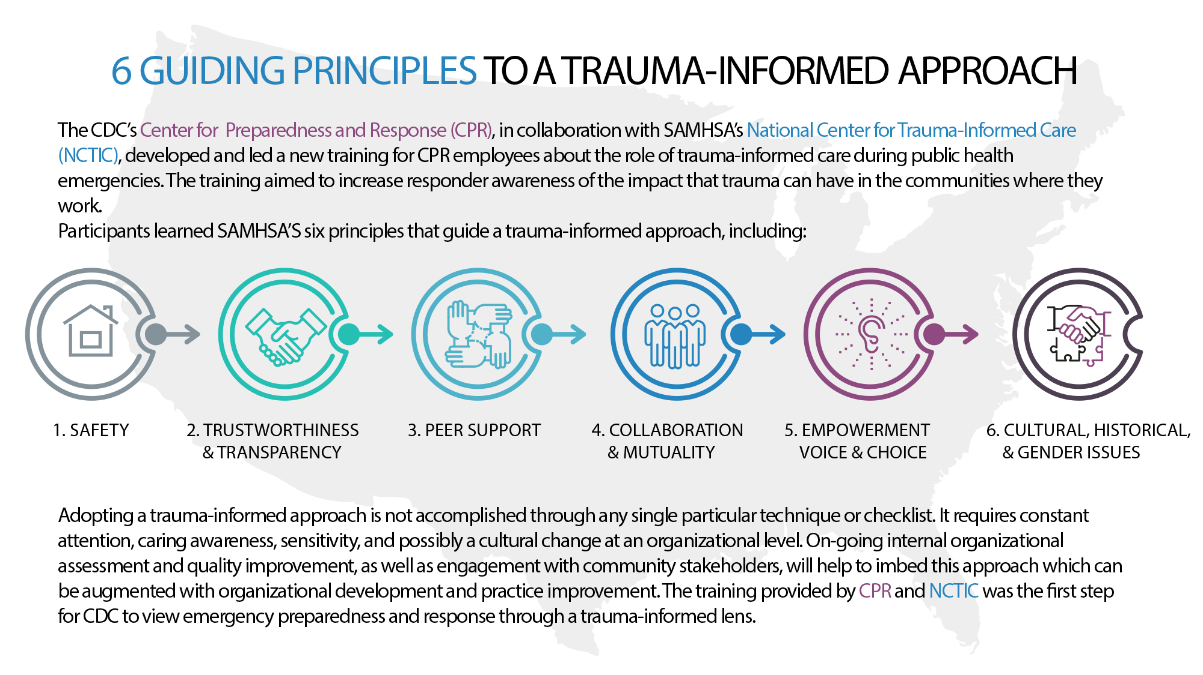
6 Guided principles to a trauma-informed approached

Slide 18


Workforce Wellness Through A Trauma-Informed Lens
Workforce Wellness has three dimensions:
Wellness approaches can be different in nature. Some can take place after work hours, while others can be structured into the job.
Interventions that take place after work time are generally personal in nature.
Those that take place during work hours tend to be more structural, being designed into an organization in a manner that can positively impact the personal and professional health of the employees and create a health-promoting work environment.
Intrapersonal level (e.g., “self care” strategies for emotional balance)
Interpersonal level (e.g., restorative justice circles)
Systemic/organizational level (e.g., robust onboarding process for new hires)

Slide 19
Wellness Approaches After Work Hours
Psychological Detachment
Relaxation
Mastery Experiences
Control During Leisure Time

Slide 20

Wellness Approaches During Work Hours
Considering ways in which a job site may be designed to be highly productive while simultaneously promoting employee health.
The balance between job demands and job resources is dynamic—that is, in a constant state of flux.
The challenge for leaders is to maintain that balance in such a manner that it promotes the personal and professional growth of employees while fulfilling the mission of the organization.
Another key aspect of a TI Wellness Approach is to build and strengthen workplace relationships.
Allow vulnerability
Engage in honest interactions
Interact with integrity
Practice empathy
Listen actively
Find opportunities for shared professional growth
Laugh together
Have patience

Slide 21
The Roadmap to a Well and Resilient Workforce
Organizational and personal assessment surveys focused on well-being.
A workshop on Trauma Informed Approaches in Higher Education and Wellness
Form workgroups to focus on TI-IHE and Wellness Initiatives
Institutional time
Evaluate efforts and activities

