Slide 1
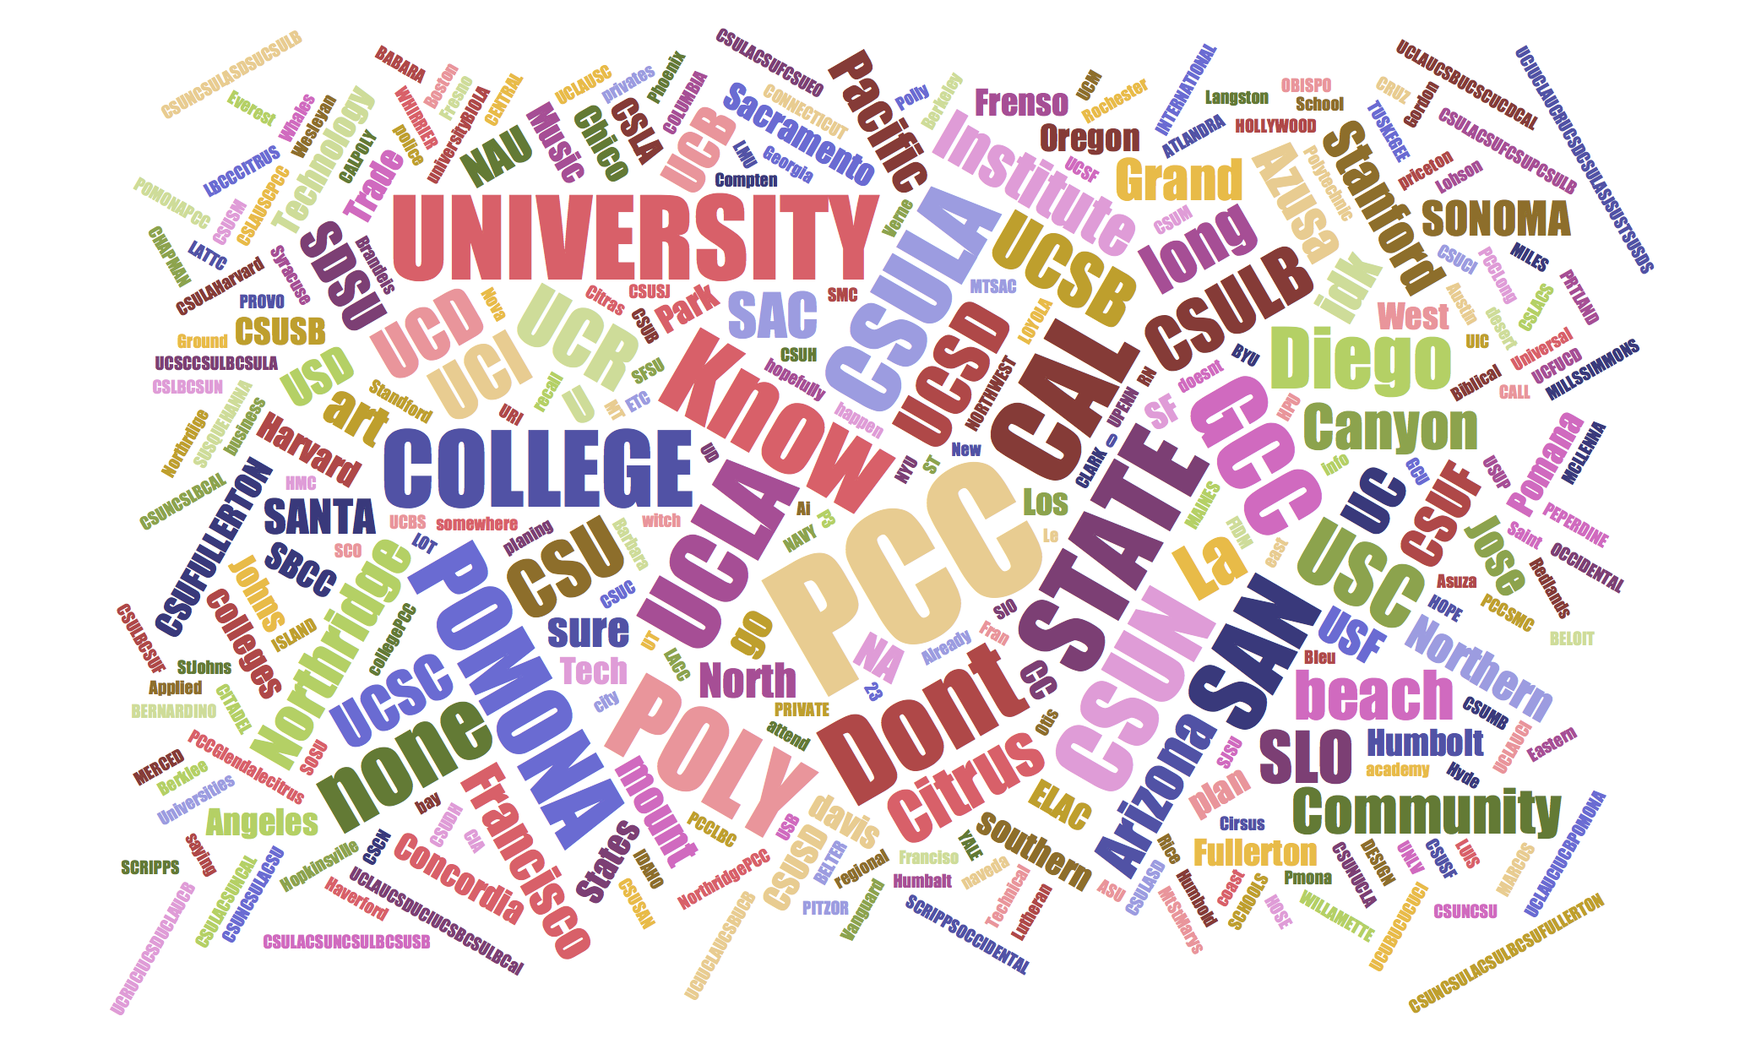
PUSD 2014 Survey Results
Career and College
Interests and Awareness

Slide 2
Student Survey Participation by School
Blair HS and Muir HS had the highest percentage of students participating in the survey. Pasadena HS only had 12% student participation.

Slide 3
Student Surveyed by School and Grade Level (N=1172)

Slide 4
Breakdown by Race*
For all three schools, the majority of students identified as Latino/Hispanic. For Blair HS and Pasadena HS, Caucasian is the second largest group. For Muir HS, African-American is the second largest group.
*Students were asked to mark “All that apply.” Thus, students who marked multiple categories were included multiple times.

Slide 5
Breakdown by Sex (N=1172)
Male and female students participated in the survey at almost equal rates at Blair and Muir High School. At Pasadena, female students participated more than males by 25%.

Slide 6
Post-Secondary Goal* (N=1140)
The majority of students (53%) were interested in working part-time and attending college. The next largest group are students who want to attend college full-time (30%). Eight percent did not know their postsecondary goal.
*Students were asked to select only ONE option.

Slide 7
Post-secondary Education Plan(s)*
There is an increase in students’ intention to attend community colleges and CSUs as they progress through high school. The inverse is true for UCs and private schools.
*Students were asked to mark “All that apply.” Thus, students who marked multiple categories were included multiple times.

Slide 8
Post-Secondary Education Word Cloud
Students most frequently answered “PCC” to the questions below:
9th to 11th graders: If you are interested in applying to a community college, which one?
12th graders: Which college/university did you apply to?

Slide 9
When did you first learn about PCC? (N=957)
Forty-two percent of students learned about PCC in middle school, 24% in elementary school, and 23% in high school.

Slide 10
Interest in Attending PCC by School* (N=580)
At all three school sites, over 60% of students indicated they were interested in attending PCC.
*Results are from two questions:
-9th to 11th graders: If you are interested in applying to a community college, which one?
-12th graders: Which college/university did you apply to?

Slide 11
Interest in Attending PCC by Grade Level* (N=580)
There is a slight decline in students’ interest in attending PCC by the 12th grade.
*Results are from two questions:
-9th to 11th graders: If you are interested in applying to a community college, which one?
-12th graders: Which college/university did you apply to?

Slide 12
To what extent do you agree with the following statements? (N=952)
 | Don't Know | Disagree | Agree
I am interested in attending PCC. | 18% | 45% | 37%
PCC has good reputation. | 41% | 28% | 31%
PCC will allow me to meet my career and/or academic goals. | 35% | 29% | 36%
Heard good things about PCC from family and/or friends. | 20% | 26% | 54%
Familiar with PCC’s Ujima Program. | 37% | 52% | 11%
Likely attend PCC because of Ujima Program. | 52% | 41% | 7%
Familiar with PCC’s Pathways programs (e.g., XL, Design Tech, Media…). | 34% | 42% | 25%
Would attend PCC because of Pathways programs. | 42% | 37% | 21%
Interested in attending PCC if I knew more about school. | 23% | 31% | 46%
I know how much it costs to attend PCC. | 40% | 36% | 25%
PCC’s tuition is affordable for me. | 51% | 16% | 33%
Attend PCC in order to transfer (e.g., CC, CSU, UC, or private univ.). | 27% | 26% | 47%

Slide 13
PUSD-PCC Connection (N=963)
Received information about PCC from my high school
Someone at my high school encouraged me to attend PCC

Slide 14
Source of Knowledge About PCC
Students learned about PCC most often from their family, friends, and teachers. Students were asked to mark “all that apply.”

Slide 15
Career Technical Education (CTE) Perceptions (N=896)
Pursuing a certificate degree (does not require 4-year degree) will allow you to: | Don't Know | Disagree | Agree
Have a successful life. | 22% | 16% | 62%
Be competitive in the global economy. | 27% | 23% | 50%
Get hands-on job experience. | 24% | 14% | 63%
Prepare me to succeed academically and professionally. | 22% | 16% | 62%
Pick from a variety of career options that will meet my interest. | 24% | 18% | 58%
Receive relevant, practical skills-training to be successful in the workplace. | 26% | 13% | 61%
Earn more than minimum wage ($8.00 per hour). | 24% | 14% | 63%
Get a positive return on my investment. | 30% | 17% | 53%
Have a solid academic foundation. | 26% | 17% | 57%

Slide 16
Careers students would be interested in pursuing*.
Students are most interested in CTEs in arts/media/entertainment, health science/medical technology, engineering/tech/design, and business/finance. *Students were asked to mark “all that apply.”
MHS
PHS

Slide 17
My classes and/or school activities covered the following topics:
BHS (N= 268)

Slide 18
Continued…
MHS (N= 244)
PHS (N= 268)

